Slide 1

IMAGE TO TEXT CONVERTER SOFTWARE ENGINEERING (Review 1)

Slide 2
TEAM MEMBERS:
2110030217 – G.SRI VARDHAN REDDY
2110030256 – R. SATYA SAI
2110030209 – ALLU JYOTHI SWAROOP
2110030307 – CH.DILEEP REDDY
SUBMITED TO :
Dr. Shadab Siddiqui

Slide 3

PROBLEM STATEMENT
To build an application which converts an image in to a editable text format .
OCR (Optical Character Recognition) technology is used in python IDE for the project.
The output is then saved in a file.

Slide 4
PROJECT REQUIREMENTS
Star UML
Python IDE
Pytesseract and open-cv packages
Python FLASK

Slide 5
LITERATURE REVIEW
This Image to text converter project is made by using OCR (Optical Character Recognition) software technology used in AI, in python IDE.
The user can upload an image if a web like interface is made and the program on run, recognizes the characters and converts into text.
The output is then stored in a file.

Slide 6
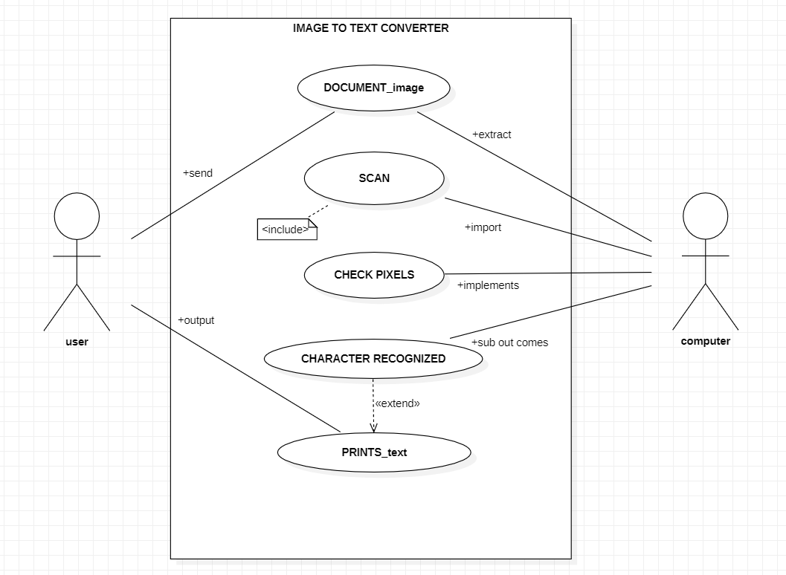
USE CASE DIAGRAM:
DESIGN MODELLING DIAGRAMS
For the diagram we can see the set of use cases ,actors and the relationship between them.
In our use case diagram we are using two actors one is user and other is computer which run only when user gives input .

Slide 7
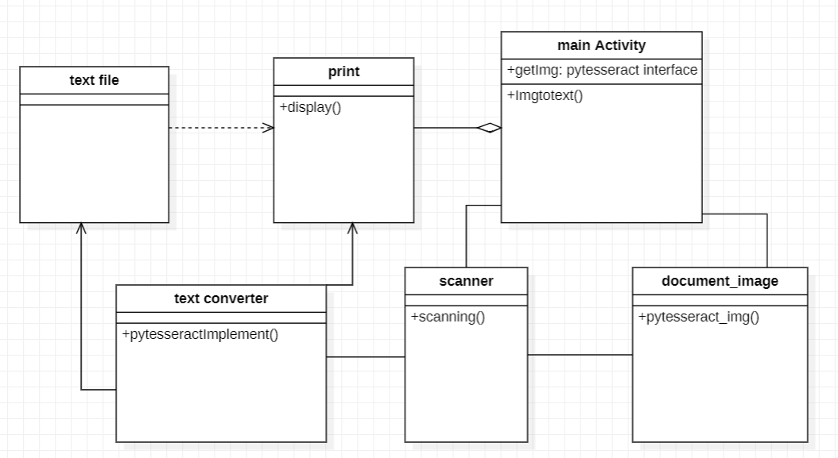
CLASS DIAGRAM
Contd..
As shown in the diagram, the class- main activity runs at last and shows the result. It is in aggregation with print class since every process till then is run and processed output is shown in it.
Dependency can be seen since the class text file needs to send the output to print class

Slide 8
DATASET COLLECTION AND TOOLS REQUIRED
Information was collected from several websites.
StarUML
Python FLASK
Pytesseract and open-cv packages

Slide 9
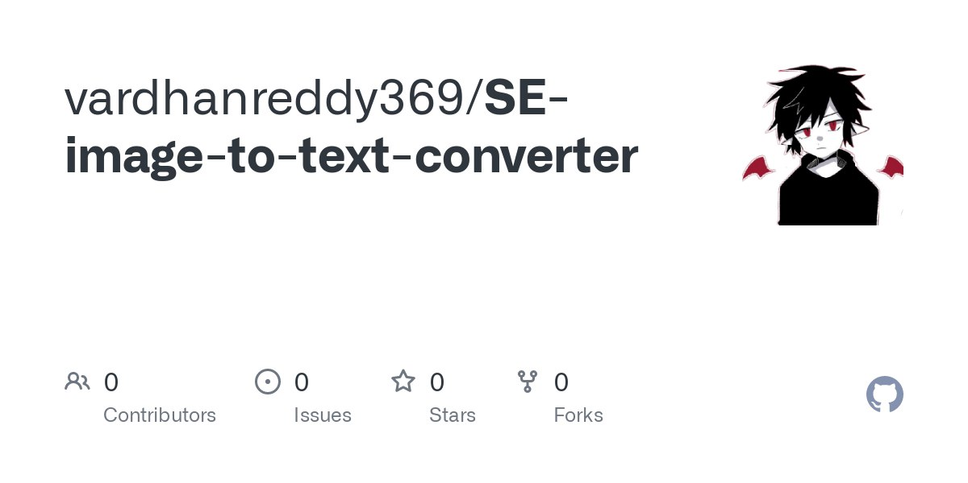
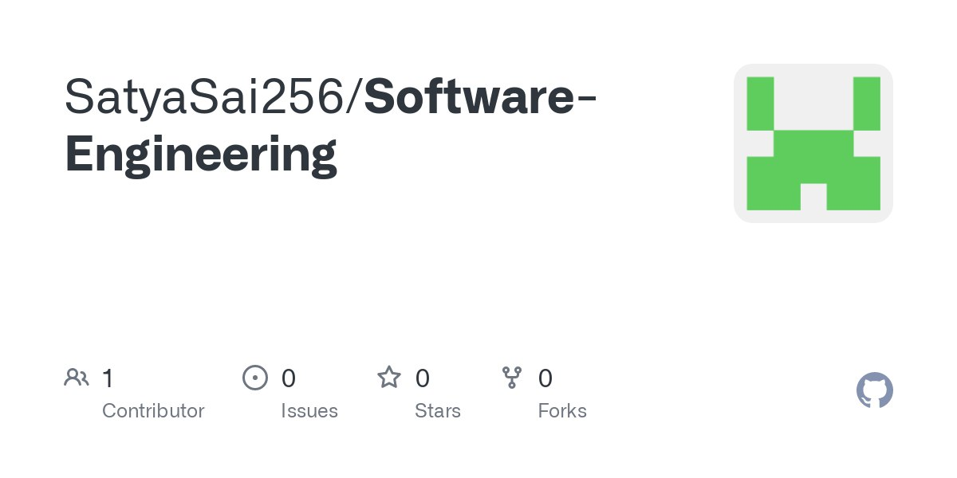
GITHUB SETUP
vardhanreddy369/SE-image-to-text-converter (github.com)
https://github.com/SatyaSai256/Software-Engineering

Slide 10
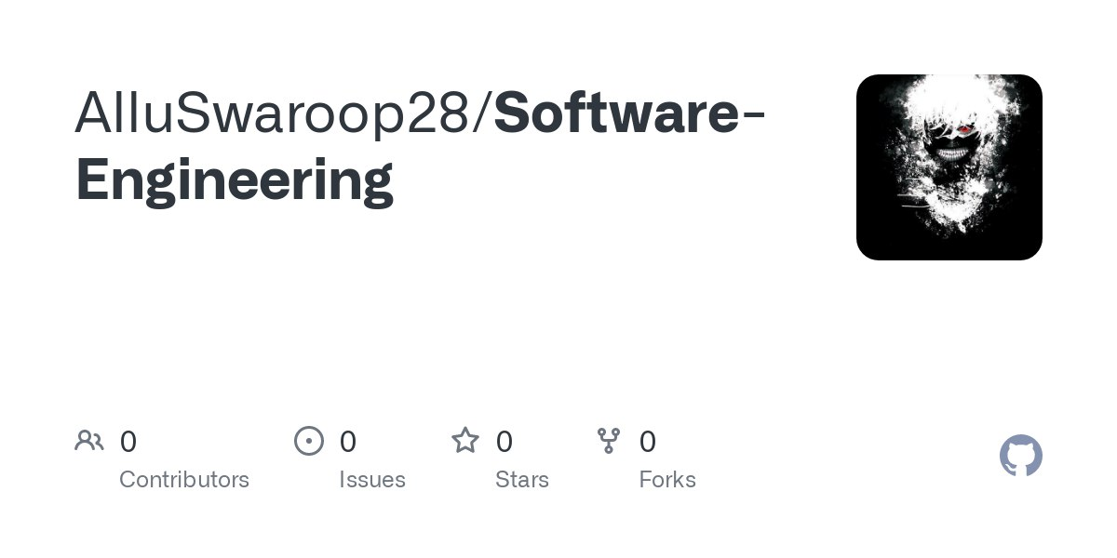
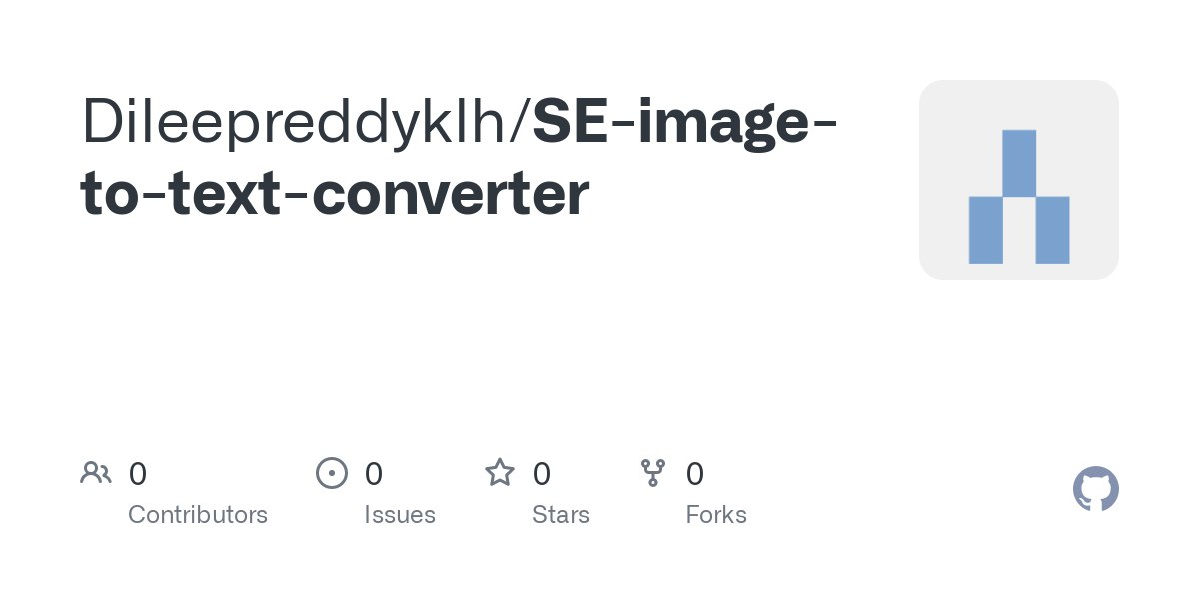
https://github.com/AlluSwaroop28/Software-Engineering
https://github.com/Dileepreddyklh/SE-image-to-text-converter

Slide 11
Division of work
2110030217 – G. SRI VARDHAN REDDY (Front end developer)
2110030256 – R. SATYA SAI (Front end developer)
2110030209 – ALLU JYOTHI SWAROOP (Back end developer)
2110030307 – CH. DILEEP REDDY (Designer, tester)

Slide 12
THANK YOU

